Slide 1

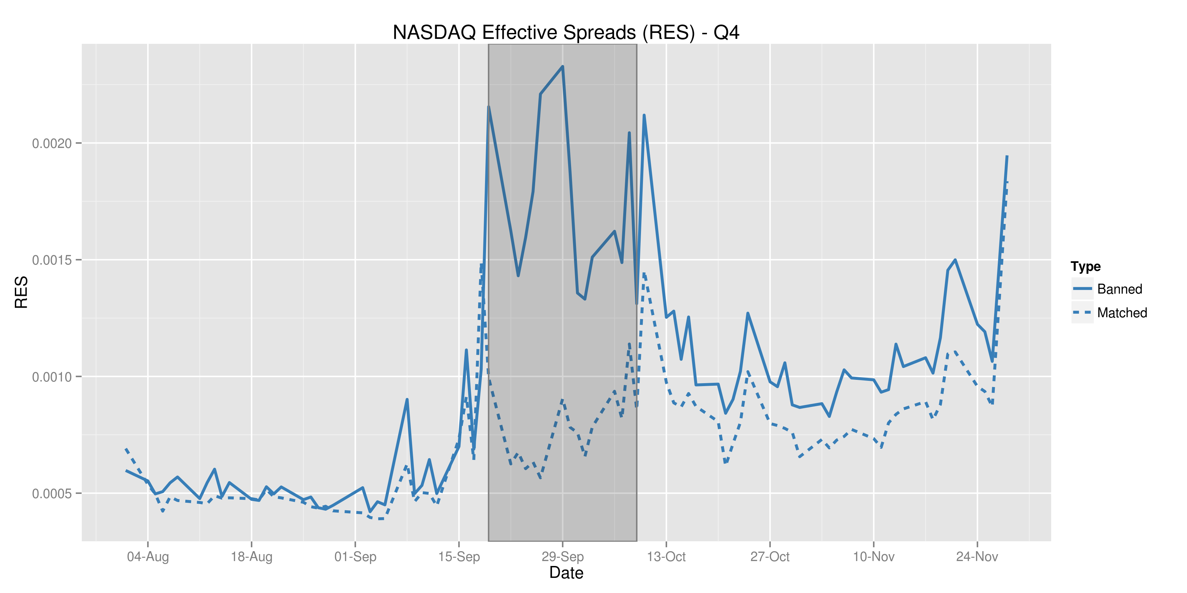
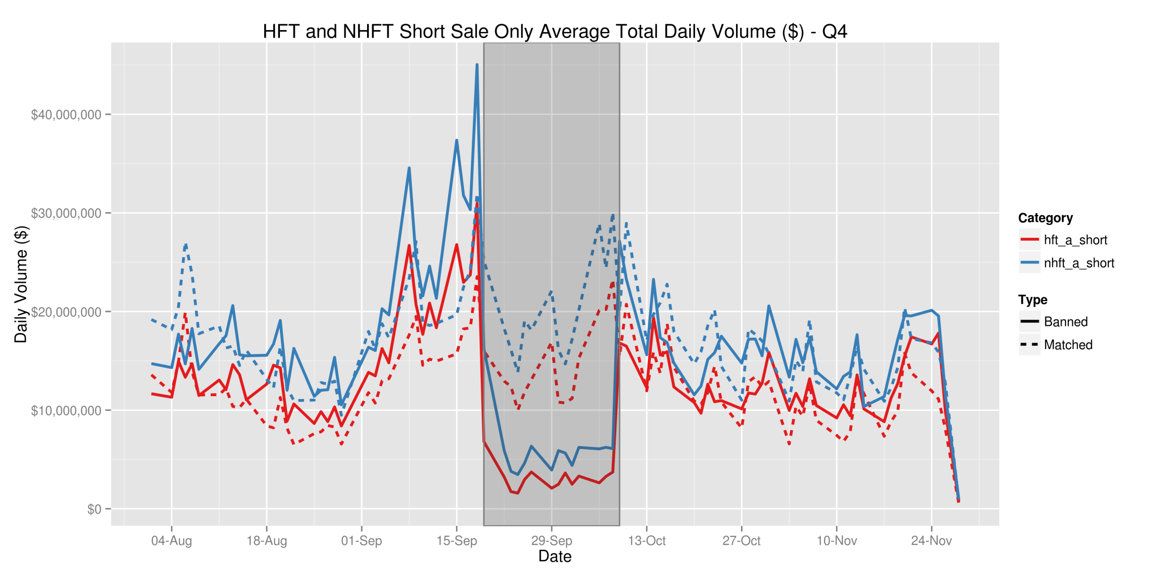
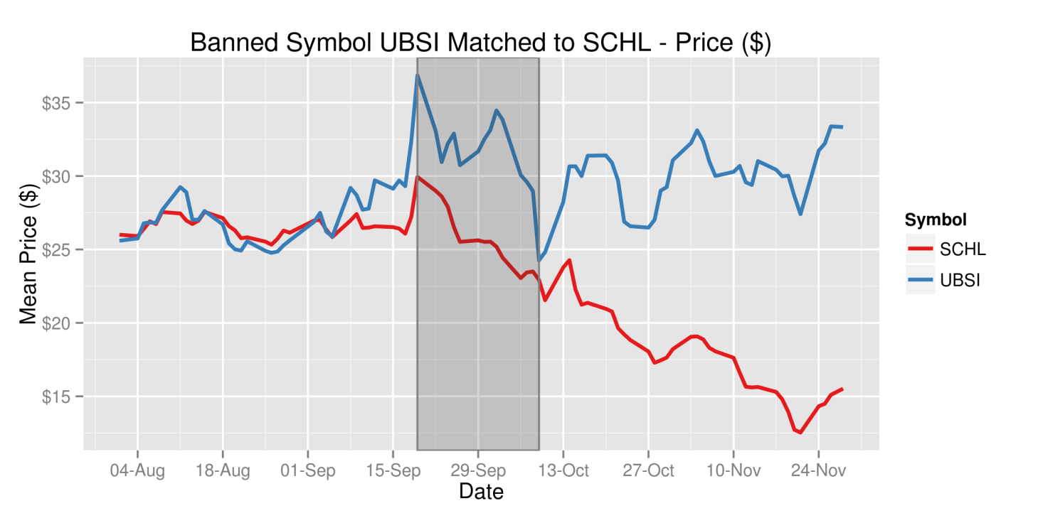
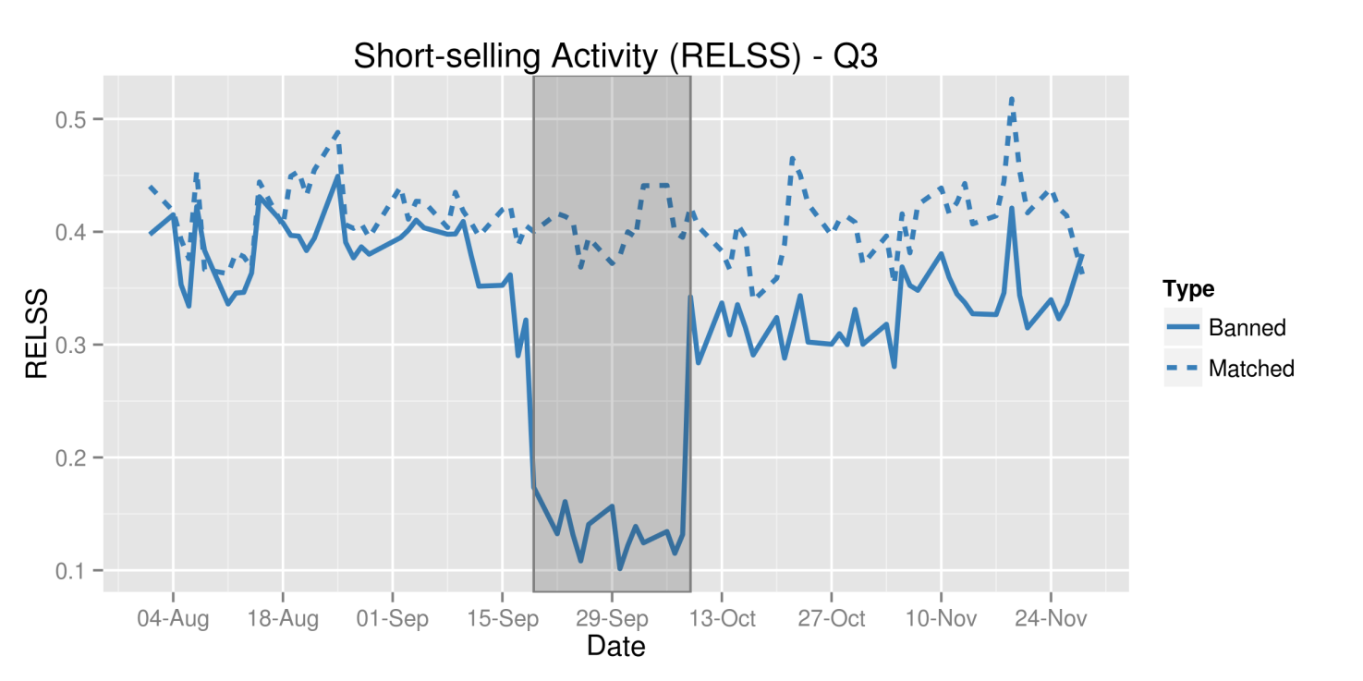
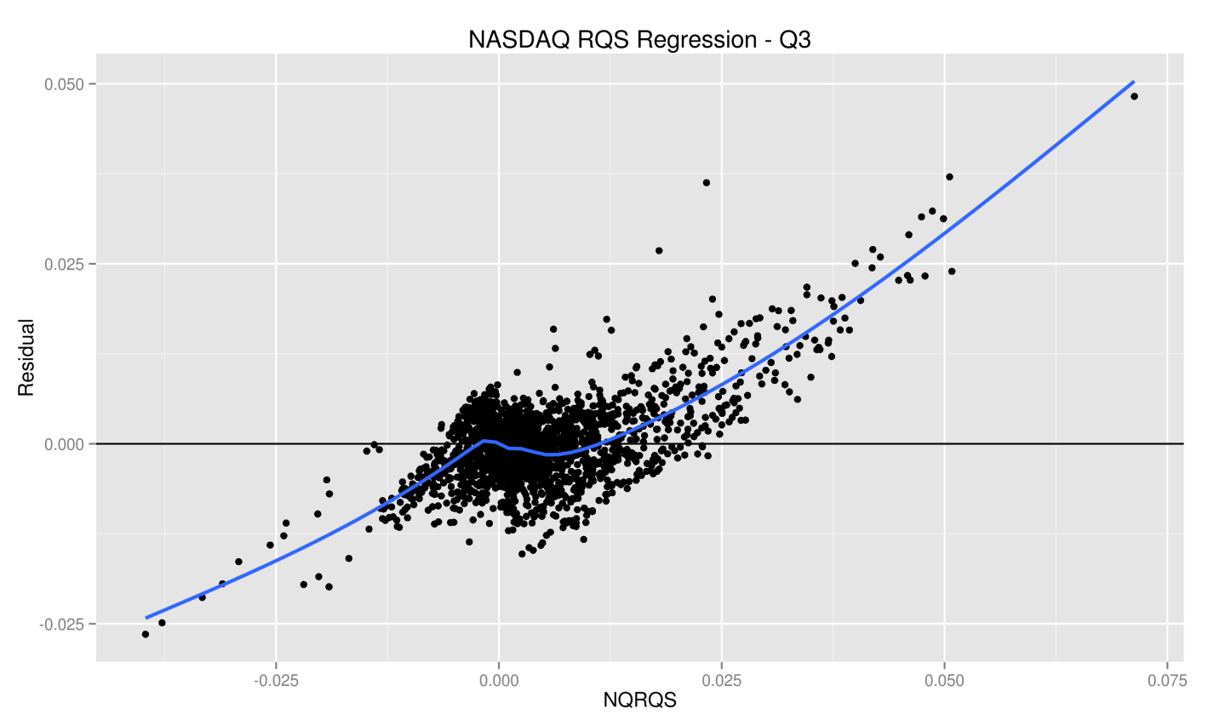

The Need for Speed: High Frequency Finance and Short Selling
Jonathan Gillett ● Ryan Riordan ● Jonathan Brogaard Faculty of Business and IT ● University of Ontario Institute of Technology ● Oshawa, Ontario, Canada
Introduction
Results
The goal of the research was to better understand the impact of the short-selling activities of high frequency traders (HFT) on market liquidity and efficiency.
Two NASDAQ databases were used, containing more than 1000 stocks over a four month period that includes a ban on short-selling during the recent financial crisis.
Our findings will help regulators, investors and market operators to better understand the impact of regulations restricting short-selling and the impact of HFT before, during and after regulatory interventions.
Market Quality Analysis
Methodology
The figures describe the impact from the ban on short-selling based on the daily averages for each market capitalization quartile, with the highlighted area representing the period in which the ban was in effect. Our results show a significant impact on larger market capitalization, which is corroborated by Boehmer, Ekkehart, Jones, and Zhang (2013).
Data Processing
Shorting Ban Market Quality Impact
NASDAQ
TAQ
Dep. Variable | Ban Dummy | DVOL | MKT CAP | RVOL | VWAP | Adj. R²
RQS | 4.454e-03 *** | -4.599e-05 ** | -1.055e-11 | 3.610e-02 *** | 1.521e-04 | 52%
RES | 1.719e-03 *** | -9.747e-06 | -4.331e-12 | 1.560e-02 *** | 3.620e-06 | 48%
RPI5 | 3.620e-06 | 3.688e-06 | 5.825e-12 | -1.083e-04 | -7.866e-07 | 2%
RVOL | 8.051e-03 *** | 4.486e-04 *** | -2.889e-10 * |  | -2.958e-04 *** | 26%
Database Identifying HFT and Short-Sales
Trade And Quote Database
Merge NASDAQ HFT data with short-sales and TAQ
Aggregate data (time and trade weighted) for analysis
Dep. Variable | Quartile 1 (Smallest) | Quartile 2 | Quartile 3 | Quartile 4 (Largest)
RQS | 8.296e-03 ** | 4.407e-03 *** | 3.598e-03 *** | 3.152e-02 ***
RES | 3.541e-03 ** | 2.046e-03 *** | 1.188e-03 *** | 5.099e-04 ***
RPI5 | 2.547e-04 | 1.415e-04 | -1.500e-04 | 6.132e-05
RVOL | 2.445e-03 | 7.127e-03 *** | 6.716e-03 ** | 1.482e-02 ***
Number of pairs | 47 | 47 | 48 | 48
Data Analysis
Calculate market quality measures and descriptive statistics
The first table describes the overall impact of the shorting ban on market quality measures, the second the impact of the ban on each market cap quartile reflected by the ban-dummy coefficients. Regressions were performed using daily panel data of the difference between each banned symbol and the corresponding match. The significance at the 10%, 5%, and 1% level are indicated by *, **, and ***.
Match banned stocks to a control group of unbanned stocks based on price, volume and market capitalization
Conclusions and Further Research
Visualization of market quality measures and descriptive statistics to aid in creating the initial design of the statistical models for regressions
The results suggest that the short-selling activities of HFT were not significantly different than those of non-HFT, which are in contrast to popular opinion.
Further research could be done to better analyze sub-populations and variances based on factors other than market capitalization quartiles, such as the attributes used to match stocks (price, volume, and market capitalization)
Statistical Modelling
Creation of statistical models
References
Assessment of models based on regression analysis with datasets
Models do not accurately explain the results based on the datasets
Boehmer, Ekkehart, Charles M. Jones, and Xiaoyan Zhang. "Shackling short sellers: The 2008 shorting ban." Review of Financial Studies 26, no. 6 (2013): 1363-1400.
Acknowledgements
Models explain the results with statistical significance
$RQS \sim ssb+market_{cap}+sum_{vol}+RVOL+VWAP+hft + hft ∗ ssb$
Research funding generously provided by UOIT as part of the Undergraduate Student Research Award.
High Performance Computing services provided freely by SHARCNET, for which this research would not have not been possible otherwise.
Notes:
1

